Slide 1
Stereo Vision
A system that helps blind people move with the help of two cameras that detects the objects and informs him about the distance through headphones.
All this processing is done on an on-board computer.

Slide 2
Abstract
Our aim in the project is to compute the depth of an object using its 2-D images generated from the stereo cameras, i.e., left and right image. For computing depth, we have used the method of triangularisation. This depth information will be conveyed to the person using a headphone.
Using IMU, we will calculate the number of steps taken by the person and sync this information using GPS(Global Positioning System). This will help us in tracking the person’s location.

Slide 3
Introduction
Computer stereo vision is the extraction of 3D information from digital images, such as obtained by a stereo camera. By comparing information about a scene from two vantage points, 3D information can be extracted by examination of the relative positions of objects in the two images.
By comparing these two images, the relative depth information can be obtained in the form of a disparity map, which encodes the difference in horizontal coordinates of corresponding image points. The values in this disparity map are inversely proportional to the scene depth at the corresponding pixel location.

Slide 4
Working
Reading images from the cameras
Computing disparity
Making disparity map
Finding the depth from disparity map.
Object Detection
Stereo matching
Generate sound to indicate the distance
Calculating number of steps
Getting the position using GPS and IMU
Tracking location

Slide 5
Implementation
Hardware and Software
IMU(Inertial Measurement Unit): Used to calculate no. of steps.
Bluetooth: Used to send data from IMU to computer
Arduino UNO: To communicate between modules and computer.
GPS module: To find and track locations.
Cameras: For taking pictures.
Headphones: For communicating with the blind.
On-board Computer: For processing the data.
OpenCV: For image processing.
Say: For Text to speech conversion.

Slide 6
Our Approach
Image Processing
After thorough study of OpenCV-core module and image processing module, we started with the code reading two images simultaneously from two cameras. Then, we computed the disparity map. After this, we implemented this in real time to generate real time disparity maps.
Now, we headed towards camera calibration. It is an important step in the project. We learnt about intrinsic and extrinsic camera parameters(like rotation and translation). After this, stereo calibration was done and the parameters generated(Q Matrix) was used to get x, y, z co-ordinates corresponding to each pixel.

Slide 7
Text to Speech
In our C++ code that was calculating the depth, we implemented the text to speech program. Using this, the depth generated was converted into speech.
Navigation
Using IMU(Inertial Measurement Unit), we calculated the numbers of steps with the help of acceleration of the person’s leg.

Slide 8
Work Done Till Now
Reading Images from two cameras simultaneously.
Computing disparity.
Generating real time disparity map.
Feature matching.
Camera calibration.
Calculating number of steps using IMU.

Slide 9
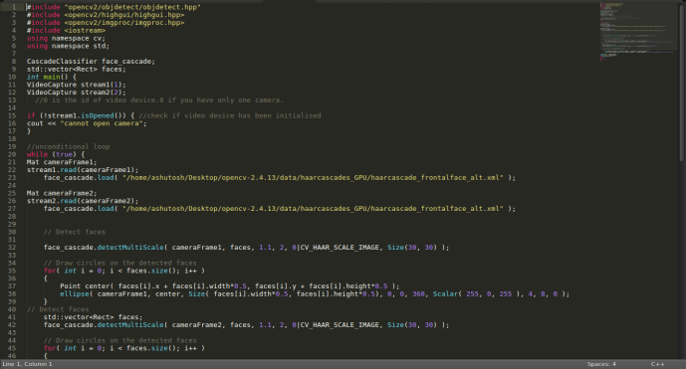
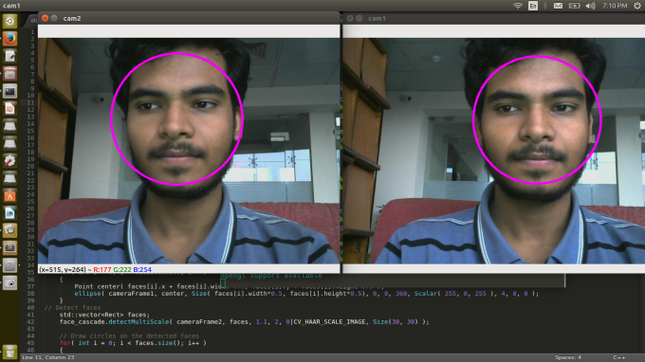
Reading Images from
Two Cameras Simultaneously

Slide 10
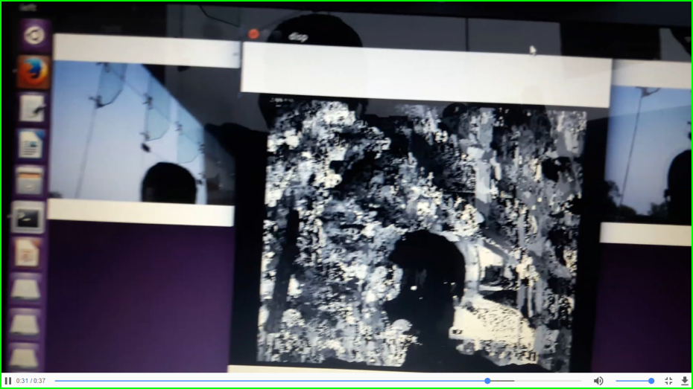
Generating Disparity Map
The pixels are given different grey values form 0 to 255 depending on their distance from the two cameras.

Slide 11
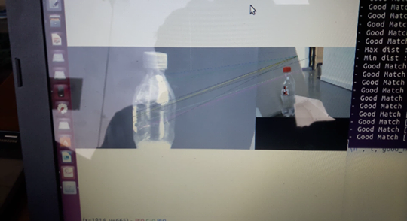
Feature Matching
Using a test image and a reference image, the keypoints are matched from test image to reference image for object detection.

Slide 12
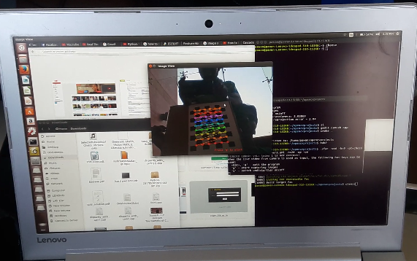
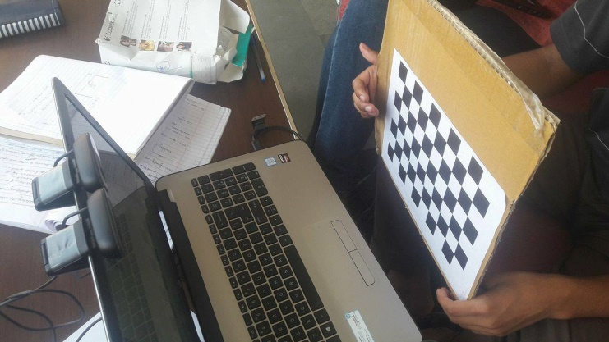
Camera Calibration
The picture taken from cameras has small amount of error. To remove this error, camera calibration is done

Slide 13
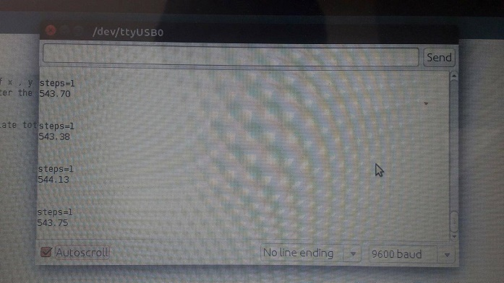
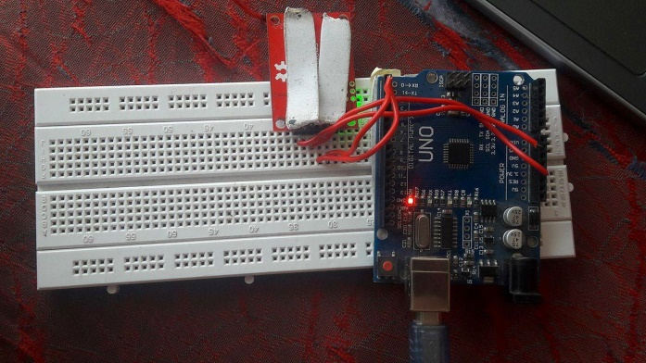
Calculating the number of steps using IMU
With the help of acceleration of the legs of person, the number of steps are calculated.

Slide 14
Links and References
Github:
https://www.github.com/ashutosk/opencvprojects/opencvfiles
Readings:
OpenCV
http://docs.opencv.org/2.4/doc/tutorials/core/table_of_content_core/table_of_content_core.html#table-of-content-core
Depth Calculation
http://ufdc.ufl.edu/UFE0046766/00001
Stereo Vision Tutorials
https://www.youtube.com/watch?v=715uLCHt4jE&list=PLmyoWnoyCKo8epWKGHAm4m_SyzoYhslk5

